Slide 1
Artificial Intelligence
Lecture 3

Slide 2
Local Search Algorithms
The search algorithms that we have seen so far are designed to explore search spaces systematically.
  This systematicity is achieved by keeping one or more paths in memory and by recording which alternatives have been explored at each point along the path.
  When a goal is found, the path to that goal also constitutes a solution to the problem. In many problems, however, the path to the goal is irrelevant.
If the path to the goal does not matter, we might consider a different class of algorithms, ones that do not worry about paths at all.
  Local search algorithms move from solution to solution in the space of candidate solutions (the search space) by applying local changes, until a solution deemed optimal is found or a time bound is elapsed.

Slide 3
Local Search Algorithms
Although local search algorithms are not systematic, they have two key advantages:
  They use very little memory—usually a constant amount; and
  They can often find reasonable solutions in large or infinite state spaces for which systematic algorithms are unsuitable.
  Two local search algorithms we will cover:
  Hill Climbing
  Genetic Algorithms

Slide 4
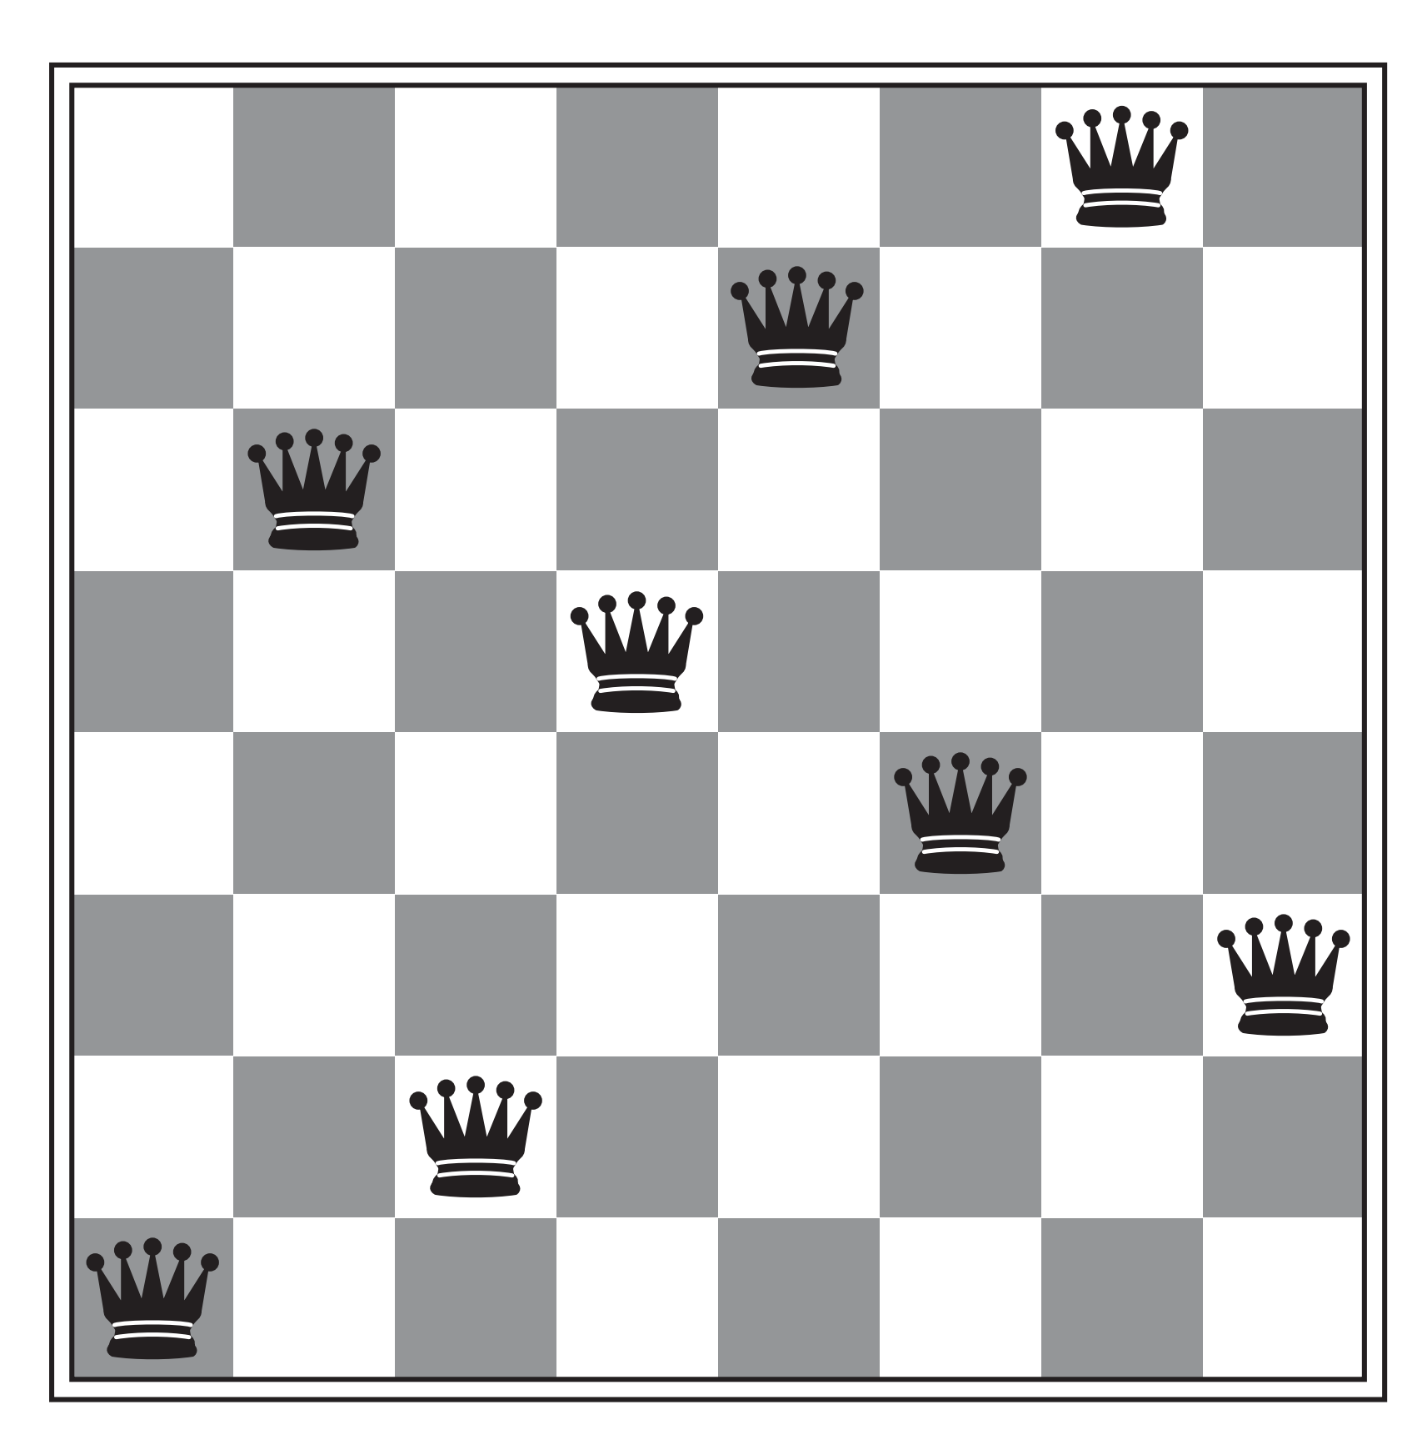
Eight Queens Problem
The goal of the 8-queens problem is to place eight queens on a chessboard such that no queen attacks any other. (A queen attacks any piece in the same row, column or diagonal.)
Figure shows an attempted solution that fails: the queen in the rightmost column is attacked by the queen at the top left.

Slide 5
Problem Formulation
States: Any arrangement of 0 to 8 queens on the board is a state.
Initial state: Eights queens on the board arranged in some random configuration.
Actions: Move queen to any empty square.
Transition model: Returns the board with a queen added to the specified square.
Goal test: 8 queens are on the board, none attacked.

Slide 6
Hill Climbing Search
Hill Climbing search is simply a loop that continually moves in the direction of increasing value—that is, uphill. It terminates when it reaches a “peak” where no neighbor has a higher value.
Hill Climbing algorithm does not maintain a search tree, so the data structure for the current node need only record the state and the value of the objective function.
Hill climbing does not look ahead beyond the immediate neighbors of the current state. This resembles trying to find the top of Mount Everest in a thick fog while suffering from amnesia.
Hill climbing is sometimes called greedy local search because it grabs a good neighbor state without thinking ahead about where to go next.

Slide 7
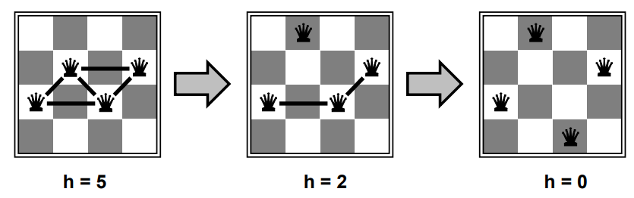
Hill Climbing (Example: n-queens)
Put n queens on an n × n board with no two queens are on the same row, column, or diagonal.
Move a queen to reduce number of conflicts.

Slide 8
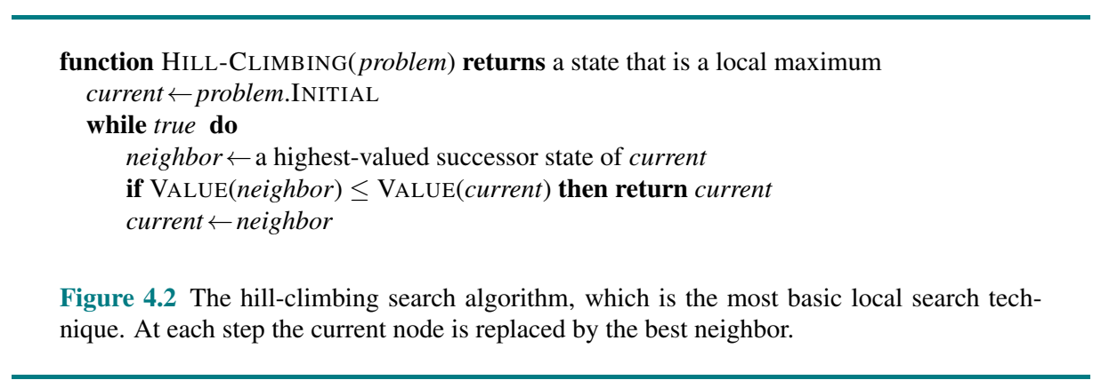
Hill-climbing Algorithm

Slide 9
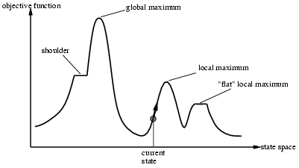
Problems with Hill-climbing search
Local Maxima: A local maximum is a peak that is higher than each of its neighboring states but lower than the global maximum.
Hill-climbing algorithms that reach the vicinity of a local maximum will be drawn upward toward the peak but will then be stuck with nowhere else to go.
Random-restart hill climbing overcomes local maxima—trivially complete

Slide 10
Problems with Hill-climbing Search
Plateau: A plateau is a flat area of the state-space landscape.
It can be a flat local maximum, from which no uphill exit exists, or a shoulder, from which progress is possible. A hill-climbing search might get lost on the plateau.
Starting from a randomly generated 8-queens state, hill climbing gets stuck 86% of the time, solving only 14% of problem instances.

Slide 11
Genetic Algorithms
Genetic algorithms are inspired by Darwin's theory of biological evolution.
Darwinism is a theory of biological evolution developed by the English naturalist Charles Darwin (1809–1882) and others.
It states that all species of organisms arise and develop through the natural selection of small, inherited variations that increase the individual's ability to compete, survive, and reproduce.
Parents (animals, humans etc.) produce a number of off springs (children) which are almost, but not entirely, like themselves.
These off springs inherit some properties from parents, while some of their own due to mutation (random changes).
Some of these off springs may survive to produce their off springs while others will not.
Genetic algorithms were formally introduced in the United States in the 1970s by John Holland at University of Michigan.

Slide 12
Gene, Chromosome, Population
Gene: A basic unit, which represents one characteristic of the
individual.
Chromosome: A string of genes; it represents an individual i.e.
a possible solution of a problem. Each chromosome represents a point in the search space.
Population: A collection of chromosomes.

Slide 13
The Basic Genetic Algorithm
Start with a population of randomly generated attempted solutions to a problem.
Repeatedly do the following:
  Evaluate each of the attempted solutions.
  Keep the best solutions.
  Produce next generation from these solutions (using crossover and mutation).
Quit when you have a satisfactory solution (or you run out of time).

Slide 14
GENETIC ALGORITHM
The Evolutionary Cycle
parents
selection
modification
modified
offspring
initiate &
population
evaluation
evaluate
evaluated offspring
deleted
members
discard

Slide 15
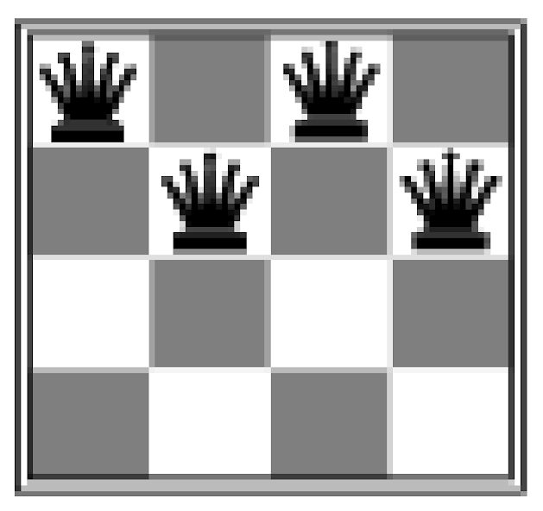
Initialization
Random initialization can be a good idea. (if the sample is large enough).
Random number generator can not be biased.
Example: n-queens
  Put n queens on an n × n board with no two queens on the same row, column, or diagonal

Slide 16
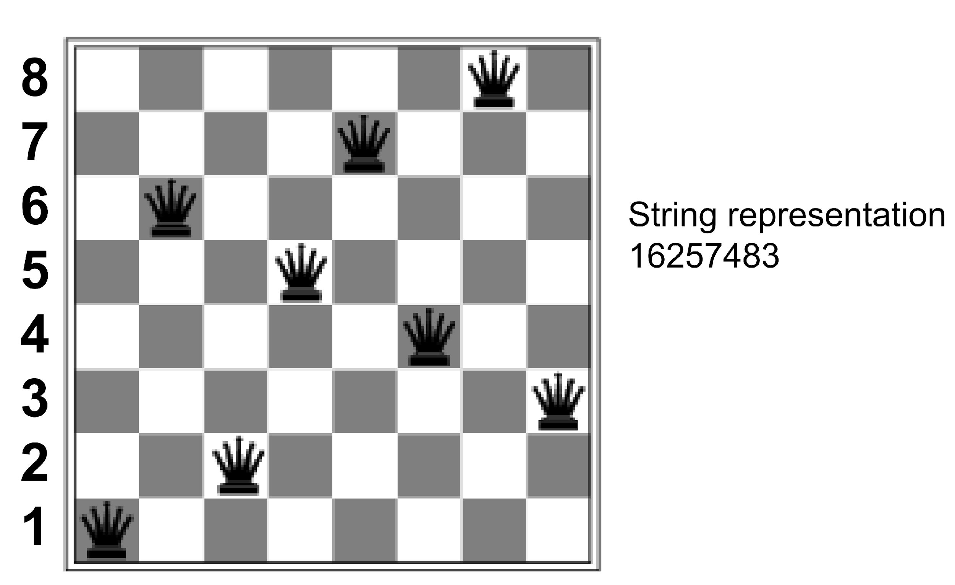
State Representation

Slide 17
Evaluation (Fitness Function)
Each member of the population can be seen as candidate solution to a problem.
The fitness function determines the quality of each solution.
Example: n-queens
  A queen can attack other queen horizontally, vertically or diagonally.
Q

Slide 18
Fitness Function
Fitness Function:
Q1 can attack NONE
Q2 can attack NONE
Q3 can attack Q6
Q4 can attack Q5
Q5 can attack Q4
Q6 can attack Q5
Q7 can attack Q4
Q8 can attack Q5
Fitness = No of. Queens that can attack none
Fitness = 2
Q8
Q1
Q4
Q7
Q5
Q6
Q2
Q3

Slide 19
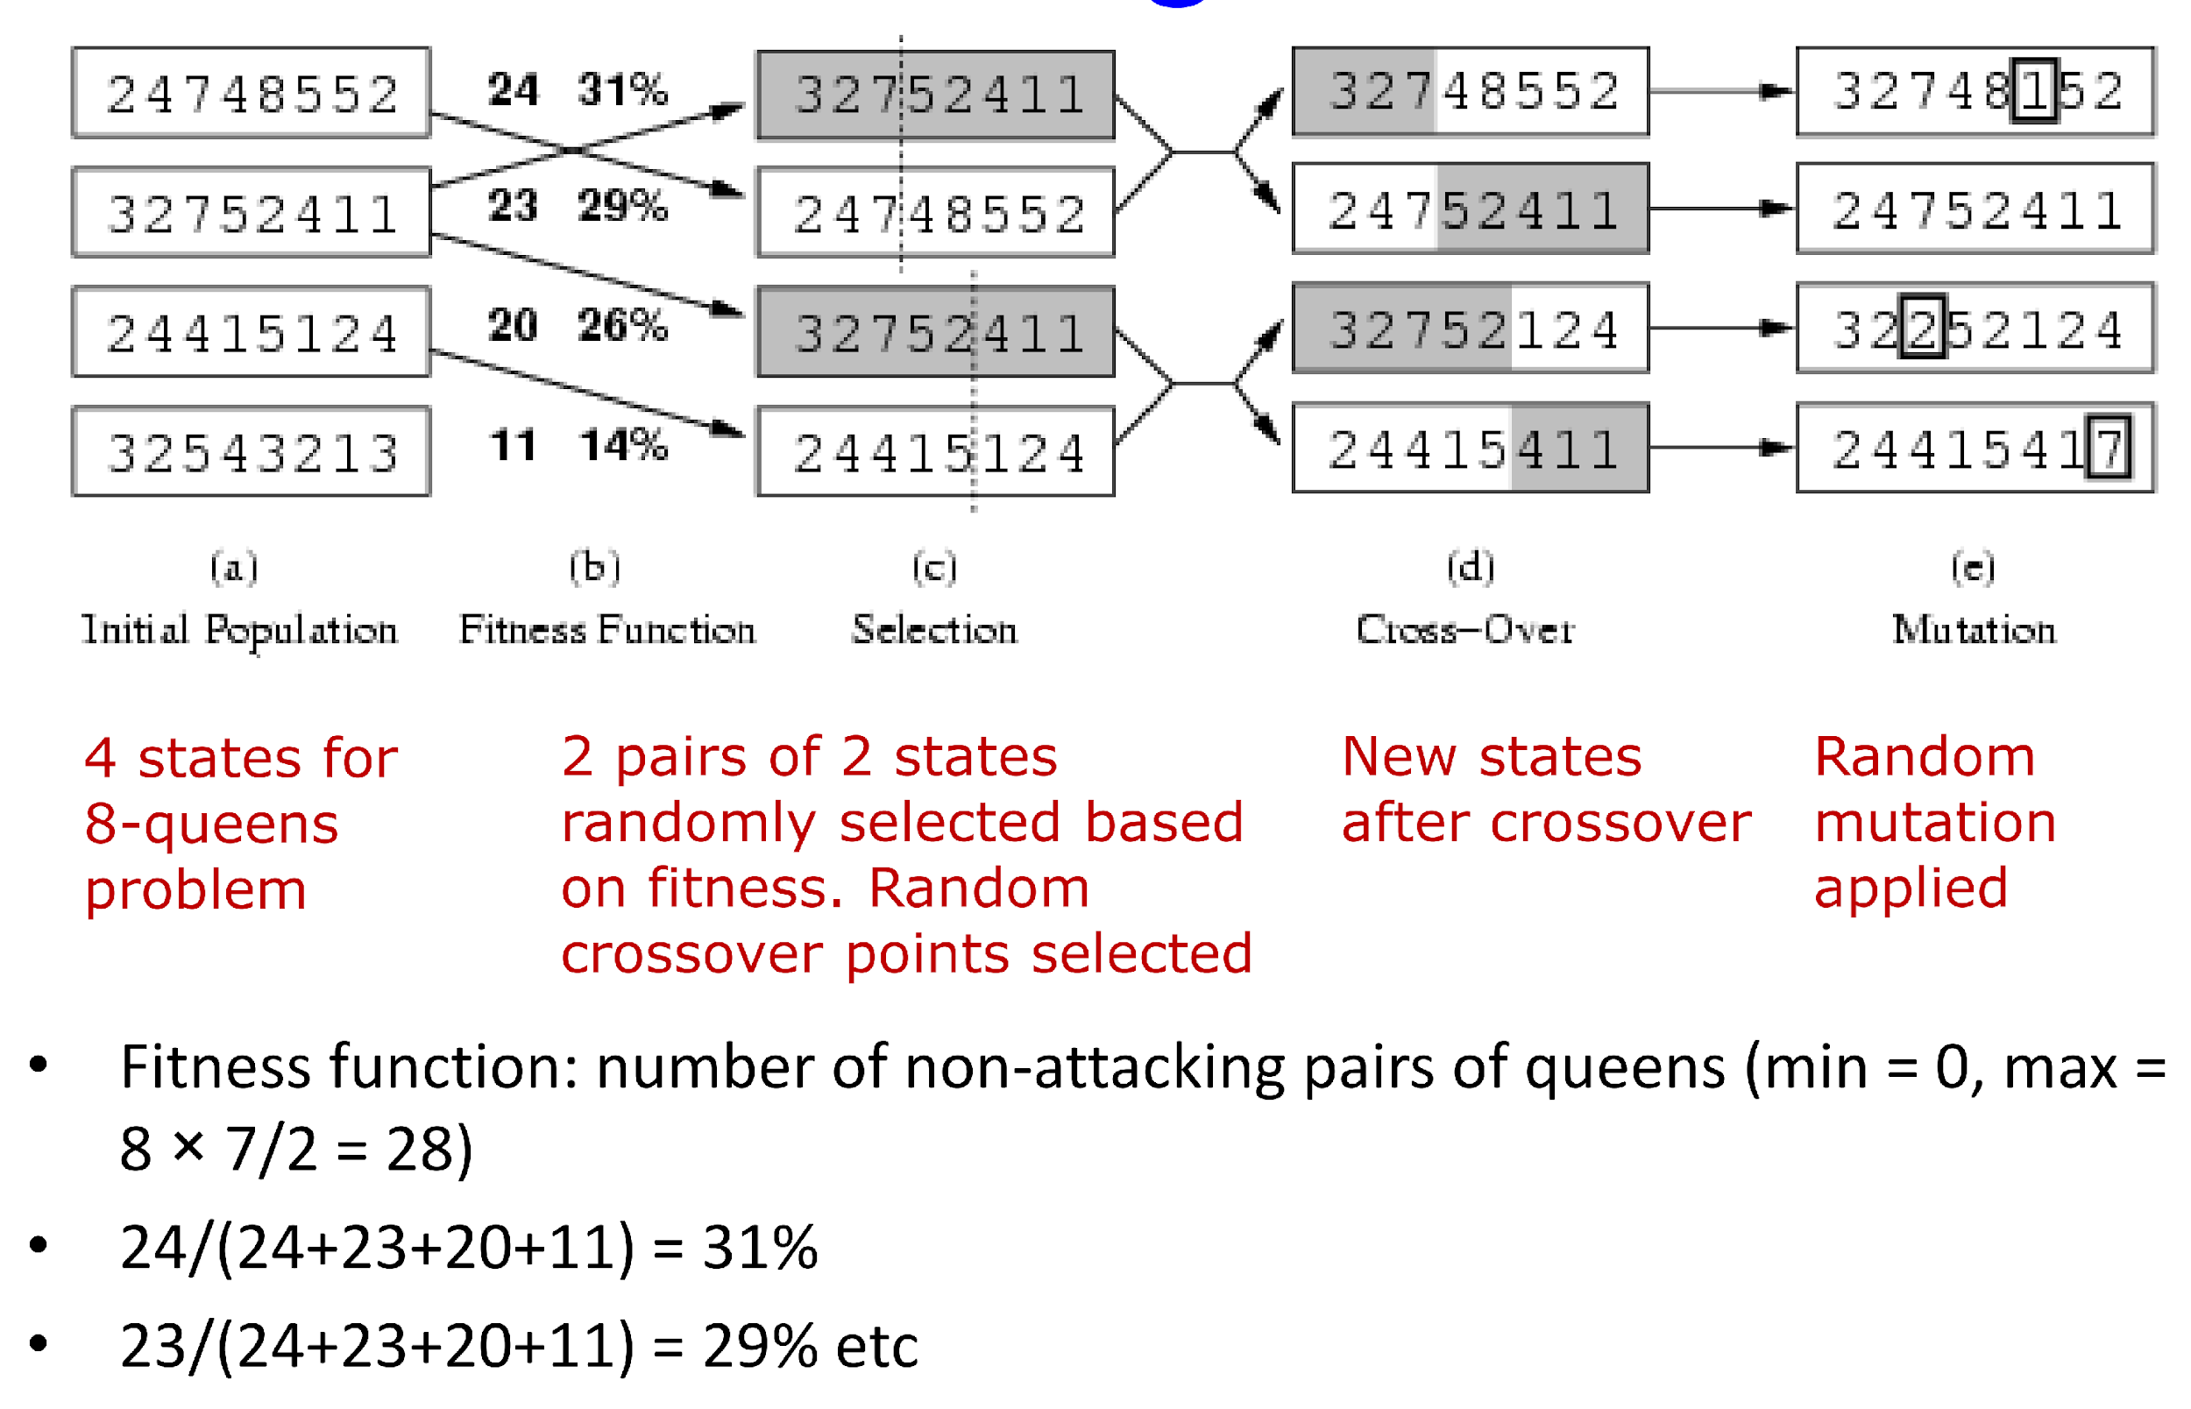
Crossover
In reproduction the genetic codes of both parents are combined to create offspring
  Would like to keep 60/40 split between parent contributions
  95/5 splits negate the benefits of crossover.

Slide 20
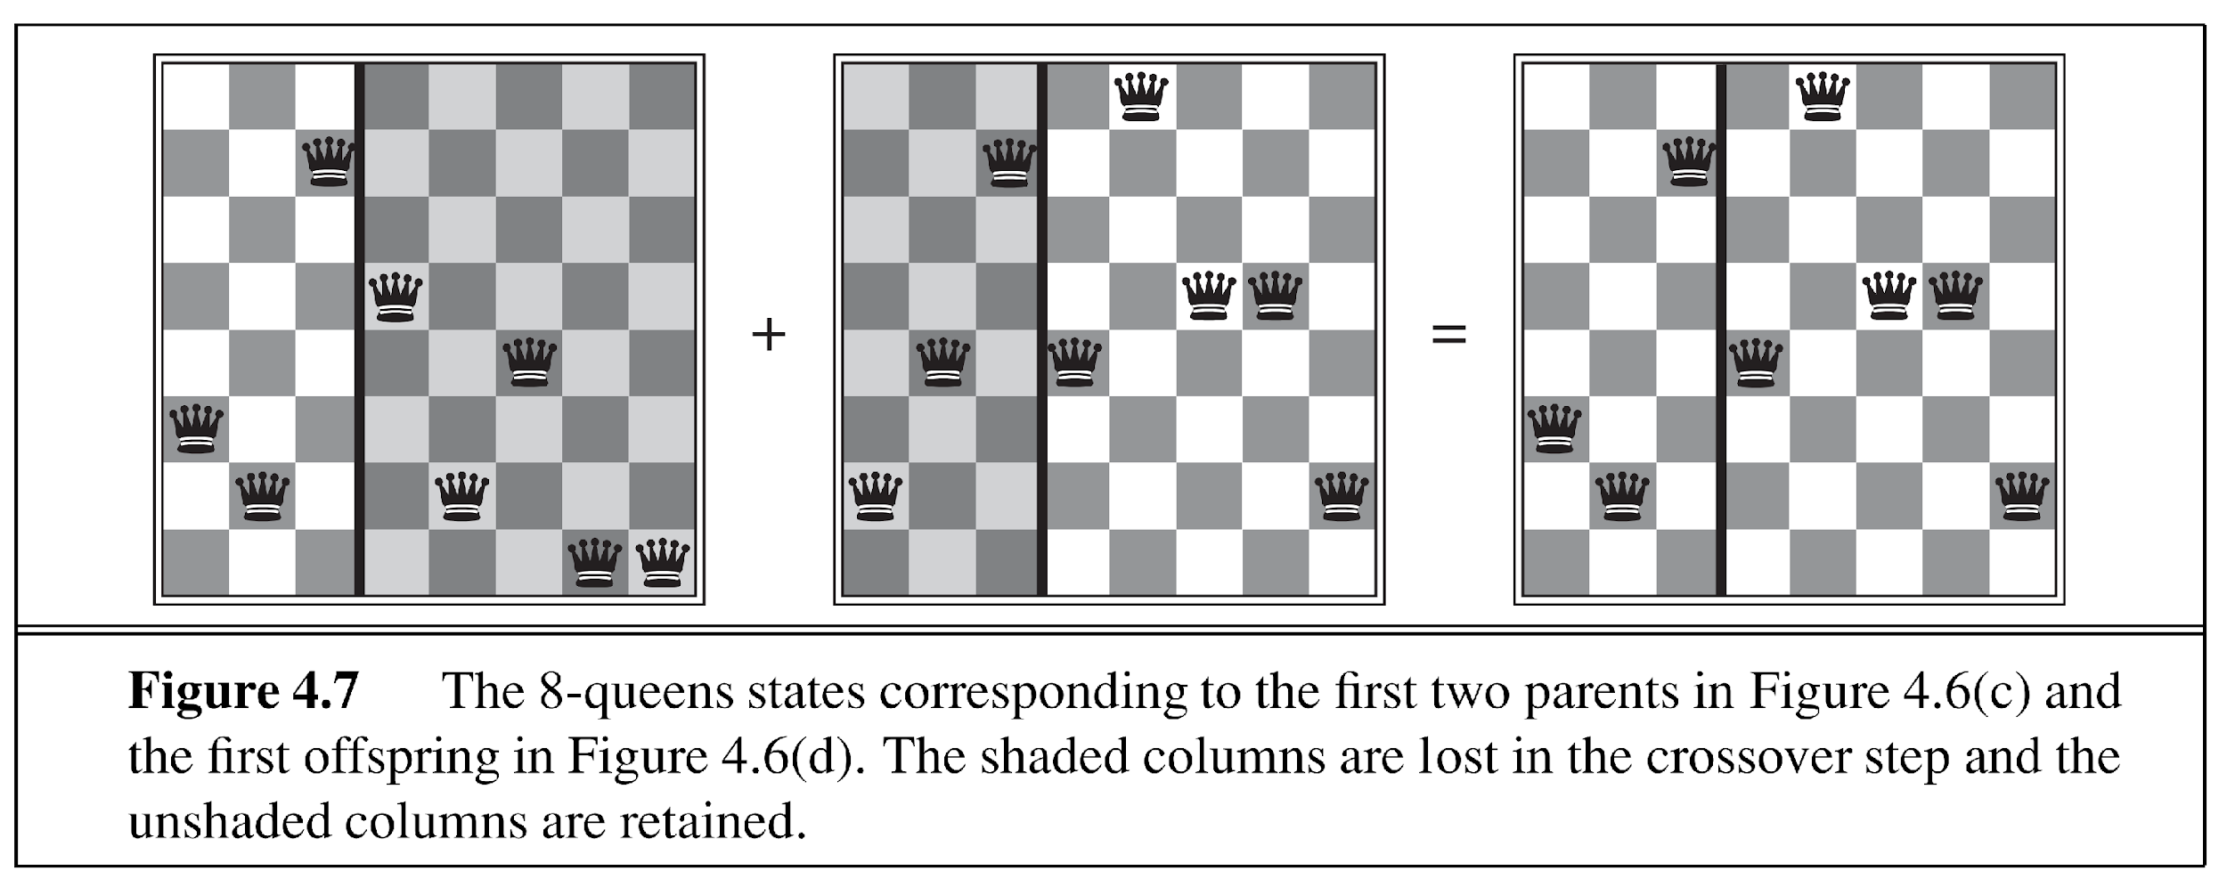
Crossover

Slide 21
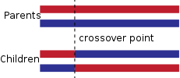
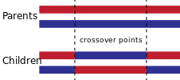
Crossover Types
Single point crossover: A point on both parents' chromosomes is picked randomly and designated a 'crossover point'. Bits to the right of that point are swapped between the two parent chromosomes. This results in two offspring, each carrying some genetic information from both parents.
Two-point crossover: In two-point crossover, two crossover points are picked randomly from the parent chromosomes. The bits in between the two points are swapped between the parent organisms.

Slide 22
Mutation
Mutation is used to maintain genetic diversity from one generation of a population of chromosomes to the next.
Mutation alters one or more gene values in a chromosome from its initial state. In mutation, the solution may change entirely from the previous solution.

Slide 23
Genetic Algorithm Flowchart
Start
Initialize Population
Evaluate Fitness of Population
Apply mutation
Crossover
No
Solution Found?
Yes
End

